Slide 1
A1: Impact and Timing of Prize-winning Papers
Shirley Wang

Slide 2
Among Nobel Prize winners in Physics, Chemistry, and Biology, what is the relationship between scientific impact of a paper and the timing of the paper during a scientist's career?
Does this relationship depend on a scientist's age, gender, team size, or prize category?

Slide 3
Variables Examined
Scientific Impact: Citation Counts
Timing: paper number / total number of papers published * 100
Age: AgeToPublish, AgeToAward, PublishToAward
Gender
Team Size: number of authors
Prize Category: Medicine, Chemistry, or Physics

Slide 4
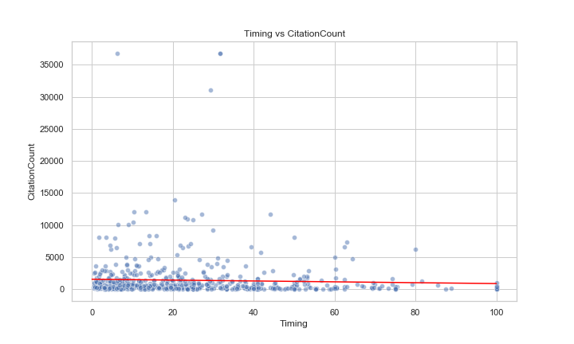
Scatterplot

Slide 5
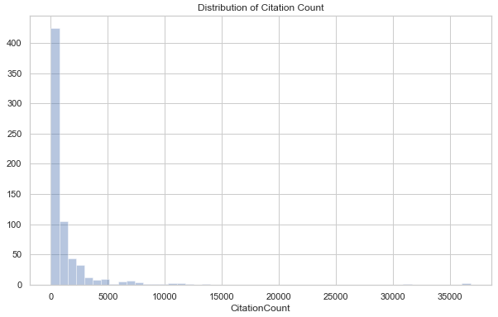
Regression Model
CitationCounts represents counts
CitationCounts is non-negative and right skewed
Poisson Time

Slide 6
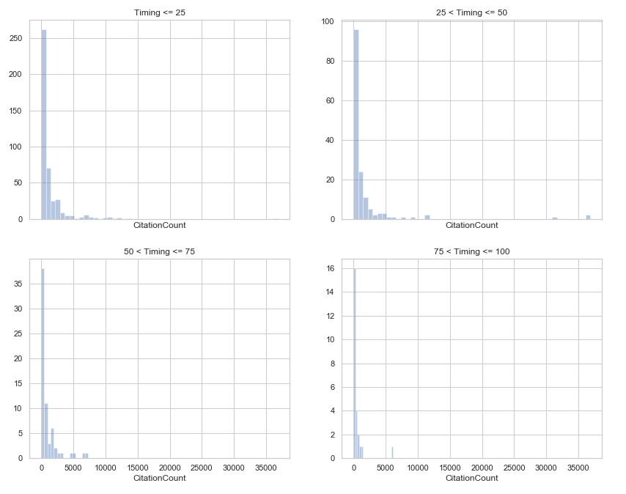

Slide 7
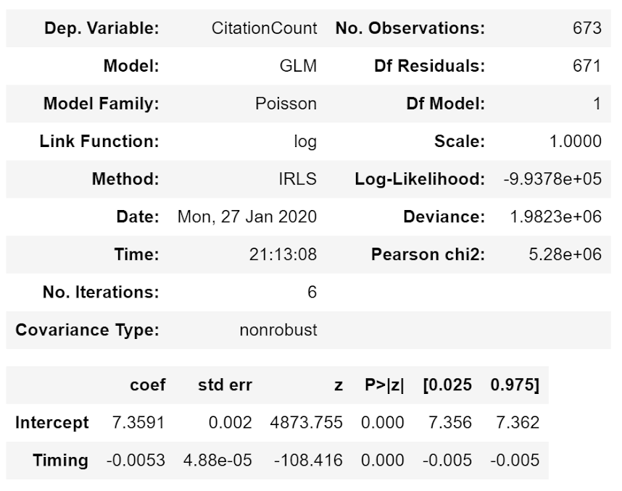
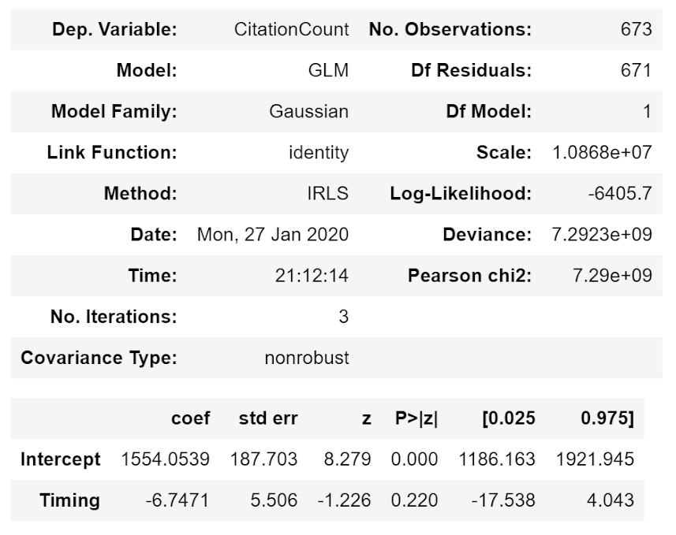
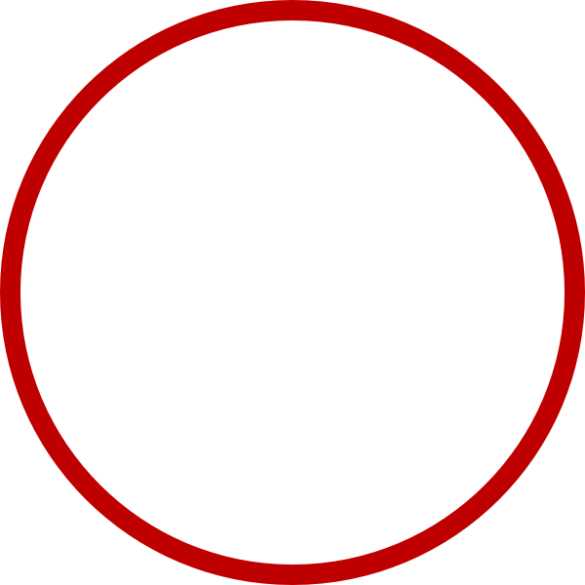
CitationCount ~ Timing

Slide 8
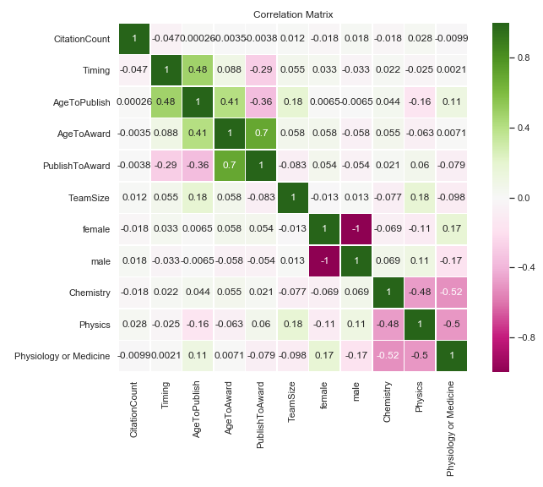

Slide 9
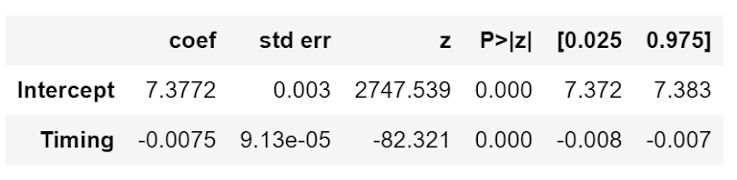
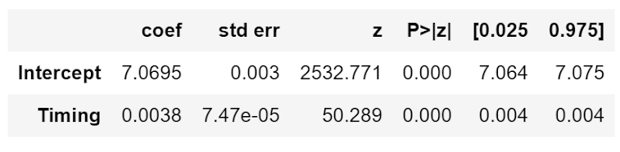

Split By Categories
Physiology or Medicine
Chemistry
Physics
Original Coefficient: -0.0053

Slide 10
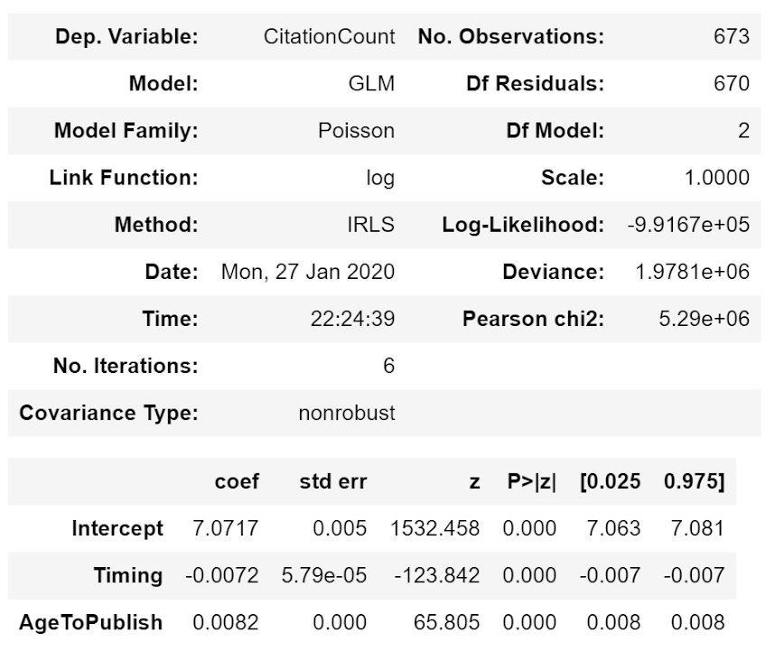
Adding Age
Timing changes from -0.0053 to -0.0072
AgeToPublish and Timing are related in the way they’re calculated

Slide 11
Thanks For Listening
Questions Now

